Slide 1
CHAPTER 2
ARRAYS AND STRUCTURES
All the programs in this file are selected from
Ellis Horowitz, Sartaj Sahni, and Susan Anderson-Freed
“Fundamentals of Data Structures in C”,
CHAPTER 2

Slide 2
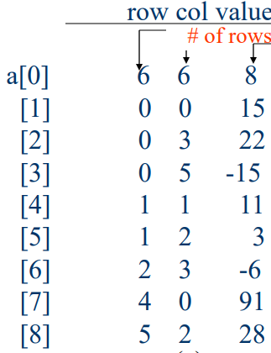
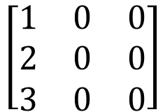
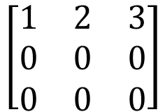
Sparse Matrix Multiplication
目的: 實作稀疏矩陣a*矩陣b
做法說明:
a
6 6 8
3 3
0 0 1
1 0 2
2 0 3
b
6 6 8
3 3
0 0 1
0 1 2
0 2 3
6 6 8
newB
3 3
0 0 1
1 0 2
2 0 3
transpose
CHAPTER 2

Slide 3
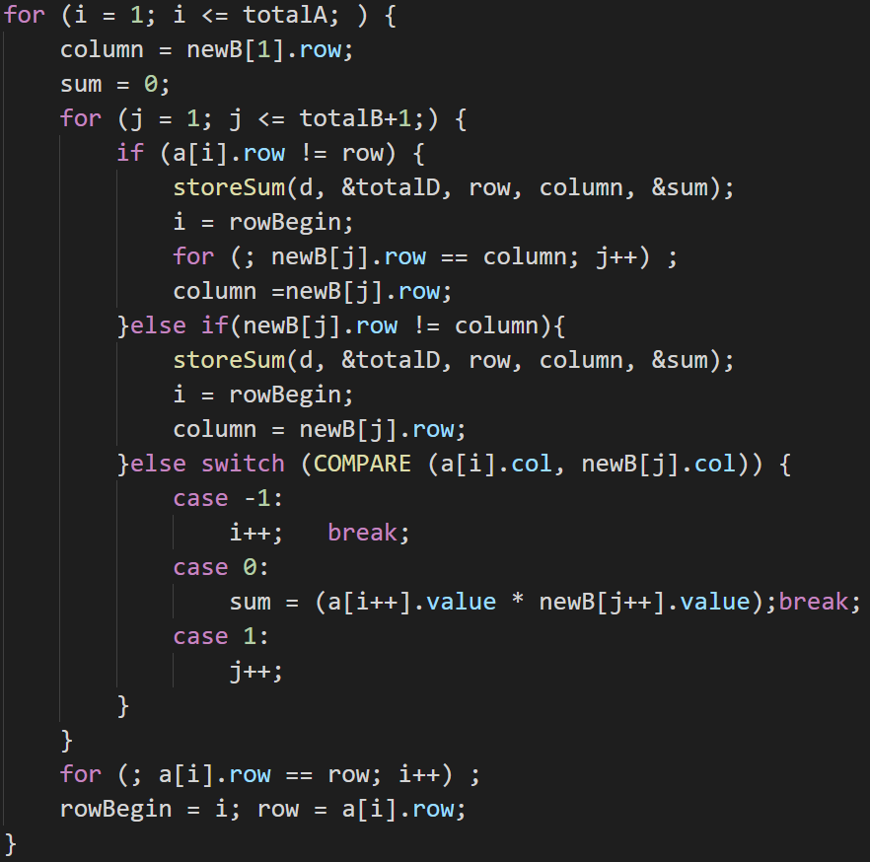
initial
rowsA=a[0].row=3 colsB=b[0].col=3
colsA=a[0].col=3
totalA=a[0].value=3 totalB=b[0].value=3
row=a[1].row=0
6 6 8
3 3 3
0 0 1
1 0 2
2 0 3
[4] 3 0 0
3 3 3
0 0 1
1 0 2
2 0 3
[4] 3 0 0
newB
6 6 8
i = 1, j = 1, rowBegin = 1, column = 0
a[i].row=0, row=0
=> False
CHAPTER 2

Slide 4
initial
rowsA=a[0].row=3 colsB=b[0].col=3
colsA=a[0].col=3
totalA=a[0].value=3 totalB=b[0].value=3
row=a[1].row=0
6 6 8
3 3 3
0 0 1
1 0 2
2 0 3
[4] 3 0 0
3 3 3
0 0 1
1 0 2
2 0 3
[4] 3 0 0
newB
6 6 8
i = 1, j = 1, rowBegin = 1, column = 0
newB[j].row=0, column=0
=> False
CHAPTER 2

Slide 5
initial
rowsA=a[0].row=3 colsB=b[0].col=3
colsA=a[0].col=3
totalA=a[0].value=3 totalB=b[0].value=3
row=a[1].row=0
6 6 8
3 3 3
0 0 1
1 0 2
2 0 3
[4] 3 0 0
3 3 3
0 0 1
1 0 2
2 0 3
[4] 3 0 0
newB
6 6 8
i = 1, j = 1, rowBegin = 1, column = 0
a[1].col=0 = newB[1].col=0
=> case 0
CHAPTER 2

Slide 6
initial
rowsA=a[0].row=3 colsB=b[0].col=3
colsA=a[0].col=3
totalA=a[0].value=3 totalB=b[0].value=3
row=a[1].row=0
6 6 8
3 3 3
0 0 1
1 0 2
2 0 3
[4] 3 0 0
3 3 3
0 0 1
1 0 2
2 0 3
[4] 3 0 0
newB
6 6 8
i = 1, j = 1, rowBegin = 1, column = 0
a[i++].value=1
newB[j++].value=1
sum=1 i=2 j=2
CHAPTER 2

Slide 7
initial
rowsA=a[0].row=3 colsB=b[0].col=3
colsA=a[0].col=3
totalA=a[0].value=3 totalB=b[0].value=3
row=a[1].row=0
6 6 8
3 3 3
0 0 1
1 0 2
2 0 3
[4] 3 0 0
3 3 3
0 0 1
1 0 2
2 0 3
[4] 3 0 0
newB
6 6 8
i = 2, j = 2, rowBegin = 1, column = 0
a[2].row=1 != row=0
=> True
CHAPTER 2

Slide 8
initial
rowsA=a[0].row=3 colsB=b[0].col=3
colsA=a[0].col=3
totalA=a[0].value=3 totalB=b[0].value=3
row=a[1].row=0
6 6 8
3 3 3
0 0 1
1 0 2
2 0 3
[4] 3 0 0
3 3 3
0 0 1
1 0 2
2 0 3
[4] 3 0 0
newB
6 6 8
i = 2, j = 2, rowBegin = 1, column = 0
[0] 0 0 0
[1] 0 0 1
[2]
[3]
[4]
[5]
[6]
[7]
[8]
[9]
d
6 6 8
CHAPTER 2

Slide 9
initial
rowsA=a[0].row=3 colsB=b[0].col=3
colsA=a[0].col=3
totalA=a[0].value=3 totalB=b[0].value=3
row=a[1].row=0
6 6 8
3 3 3
0 0 1
1 0 2
2 0 3
[4] 3 0 0
3 3 3
0 0 1
1 0 2
2 0 3
[4] 3 0 0
newB
6 6 8
i = 2, j = 2, rowBegin = 1, column = 0
i=1 j=2 column=1
CHAPTER 2

Slide 10
initial
rowsA=a[0].row=3 colsB=b[0].col=3
colsA=a[0].col=3
totalA=a[0].value=3 totalB=b[0].value=3
row=a[1].row=0
6 6 8
3 3 3
0 0 1
1 0 2
2 0 3
[4] 3 0 0
3 3 3
0 0 1
1 0 2
2 0 3
[4] 3 0 0
newB
6 6 8
i = 1, j = 2, rowBegin = 1, column = 1
a[1].row=0, row=0
=> False
CHAPTER 2

Slide 11
initial
rowsA=a[0].row=3 colsB=b[0].col=3
colsA=a[0].col=3
totalA=a[0].value=3 totalB=b[0].value=3
row=a[1].row=0
6 6 8
3 3 3
0 0 1
1 0 2
2 0 3
[4] 3 0 0
3 3 3
0 0 1
1 0 2
2 0 3
[4] 3 0 0
newB
6 6 8
i = 1, j = 2, rowBegin = 1, column = 1
newB[j].row=1, column=1
=> False
CHAPTER 2

Slide 12
initial
rowsA=a[0].row=3 colsB=b[0].col=3
colsA=a[0].col=3
totalA=a[0].value=3 totalB=b[0].value=3
row=a[1].row=0
6 6 8
3 3 3
0 0 1
1 0 2
2 0 3
[4] 3 0 0
3 3 3
0 0 1
1 0 2
2 0 3
[4] 3 0 0
newB
6 6 8
i = 1, j = 2, rowBegin = 1, column = 1
a[1].col=0 = newB[2].col=0
=> case 0
CHAPTER 2

Slide 13
initial
rowsA=a[0].row=3 colsB=b[0].col=3
colsA=a[0].col=3
totalA=a[0].value=3 totalB=b[0].value=3
row=a[1].row=0
6 6 8
3 3 3
0 0 1
1 0 2
2 0 3
[4] 3 0 0
3 3 3
0 0 1
1 0 2
2 0 3
[4] 3 0 0
newB
6 6 8
i = 1, j = 2, rowBegin = 1, column = 1
a[i++].value=1
newB[j++].value=2
sum=2 i=2 j=3
CHAPTER 2

Slide 14
initial
rowsA=a[0].row=3 colsB=b[0].col=3
colsA=a[0].col=3
totalA=a[0].value=3 totalB=b[0].value=3
row=a[1].row=0
6 6 8
3 3 3
0 0 1
1 0 2
2 0 3
[4] 3 0 0
3 3 3
0 0 1
1 0 2
2 0 3
[4] 3 0 0
newB
6 6 8
i = 2, j = 3, rowBegin = 1, column = 1
a[2].row=1, row=0
=> True
CHAPTER 2

Slide 15
initial
rowsA=a[0].row=3 colsB=b[0].col=3
colsA=a[0].col=3
totalA=a[0].value=3 totalB=b[0].value=3
row=a[1].row=0
6 6 8
3 3 3
0 0 1
1 0 2
2 0 3
[4] 3 0 0
3 3 3
0 0 1
1 0 2
2 0 3
[4] 3 0 0
newB
6 6 8
i = 2, j = 3, rowBegin = 1, column = 1
[0] 0 0 0
[1] 0 0 1
[2] 0 1 2
[3]
[4]
[5]
[6]
[7]
[8]
[9]
d
6 6 8
CHAPTER 2

Slide 16
initial
rowsA=a[0].row=3 colsB=b[0].col=3
colsA=a[0].col=3
totalA=a[0].value=3 totalB=b[0].value=3
row=a[1].row=0
6 6 8
3 3 3
0 0 1
1 0 2
2 0 3
[4] 3 0 0
3 3 3
0 0 1
1 0 2
2 0 3
[4] 3 0 0
newB
6 6 8
i = 2, j = 3, rowBegin = 1, column = 1
i=1 j=3 column=2
CHAPTER 2

Slide 17
initial
rowsA=a[0].row=3 colsB=b[0].col=3
colsA=a[0].col=3
totalA=a[0].value=3 totalB=b[0].value=3
row=a[1].row=0
6 6 8
3 3 3
0 0 1
1 0 2
2 0 3
[4] 3 0 0
3 3 3
0 0 1
1 0 2
2 0 3
[4] 3 0 0
newB
6 6 8
i = 1, j = 3, rowBegin = 1, column = 2
a[1].row=0, row=0
=> False
CHAPTER 2

Slide 18
initial
rowsA=a[0].row=3 colsB=b[0].col=3
colsA=a[0].col=3
totalA=a[0].value=3 totalB=b[0].value=3
row=a[1].row=0
6 6 8
3 3 3
0 0 1
1 0 2
2 0 3
[4] 3 0 0
3 3 3
0 0 1
1 0 2
2 0 3
[4] 3 0 0
newB
6 6 8
i = 1, j = 3, rowBegin = 1, column = 2
newB[j].row=2, column=2
=> False
CHAPTER 2

Slide 19
initial
rowsA=a[0].row=3 colsB=b[0].col=3
colsA=a[0].col=3
totalA=a[0].value=3 totalB=b[0].value=3
row=a[1].row=0
6 6 8
3 3 3
0 0 1
1 0 2
2 0 3
[4] 3 0 0
3 3 3
0 0 1
1 0 2
2 0 3
[4] 3 0 0
newB
6 6 8
i = 1, j = 3, rowBegin = 1, column = 2
a[1].col=0 = newB[3].col=0
=> case 0
CHAPTER 2

Slide 20
initial
rowsA=a[0].row=3 colsB=b[0].col=3
colsA=a[0].col=3
totalA=a[0].value=3 totalB=b[0].value=3
row=a[1].row=0
6 6 8
3 3 3
0 0 1
1 0 2
2 0 3
[4] 3 0 0
3 3 3
0 0 1
1 0 2
2 0 3
[4] 3 0 0
newB
6 6 8
i = 1, j = 3, rowBegin = 1, column = 2
a[i++].value=1
newB[j++].value=3
sum=3 i=2 j=4
CHAPTER 2

Slide 21
initial
rowsA=a[0].row=3 colsB=b[0].col=3
colsA=a[0].col=3
totalA=a[0].value=3 totalB=b[0].value=3
row=a[1].row=0
6 6 8
3 3 3
0 0 1
1 0 2
2 0 3
[4] 3 0 0
3 3 3
0 0 1
1 0 2
2 0 3
[4] 3 0 0
newB
6 6 8
i = 2, j = 4, rowBegin = 1, column = 2
a[2].row=1, row=0
=> True
CHAPTER 2

Slide 22
initial
rowsA=a[0].row=3 colsB=b[0].col=3
colsA=a[0].col=3
totalA=a[0].value=3 totalB=b[0].value=3
row=a[1].row=0
6 6 8
3 3 3
0 0 1
1 0 2
2 0 3
[4] 3 0 0
3 3 3
0 0 1
1 0 2
2 0 3
[4] 3 0 0
newB
6 6 8
i = 2, j = 4, rowBegin = 1, column = 2
[0] 0 0 0
[1] 0 0 1
[2] 0 1 2
[3] 0 2 3
[4]
[5]
[6]
[7]
[8]
[9]
d
6 6 8
CHAPTER 2

Slide 23
initial
rowsA=a[0].row=3 colsB=b[0].col=3
colsA=a[0].col=3
totalA=a[0].value=3 totalB=b[0].value=3
row=a[1].row=0
6 6 8
3 3 3
0 0 1
1 0 2
2 0 3
[4] 3 0 0
3 3 3
0 0 1
1 0 2
2 0 3
[4] 3 0 0
newB
6 6 8
i = 2, j = 4, rowBegin = 1, column = 2
i=1 j=4 column=3
CHAPTER 2

Slide 24
initial
rowsA=a[0].row=3 colsB=b[0].col=3
colsA=a[0].col=3
totalA=a[0].value=3 totalB=b[0].value=3
row=a[1].row=0
6 6 8
3 3 3
0 0 1
1 0 2
2 0 3
[4] 3 0 0
3 3 3
0 0 1
1 0 2
2 0 3
[4] 3 0 0
newB
6 6 8
i = 1, j = 4, rowBegin = 1, column = 3
a[1].row=0, row=0
=> False
CHAPTER 2

Slide 25
initial
rowsA=a[0].row=3 colsB=b[0].col=3
colsA=a[0].col=3
totalA=a[0].value=3 totalB=b[0].value=3
row=a[1].row=0
6 6 8
3 3 3
0 0 1
1 0 2
2 0 3
[4] 3 0 0
3 3 3
0 0 1
1 0 2
2 0 3
[4] 3 0 0
newB
6 6 8
i = 1, j = 4, rowBegin = 1, column = 3
newB[j].row=3, column=3
=> False
CHAPTER 2

Slide 26
initial
rowsA=a[0].row=3 colsB=b[0].col=3
colsA=a[0].col=3
totalA=a[0].value=3 totalB=b[0].value=3
row=a[1].row=0
6 6 8
3 3 3
0 0 1
1 0 2
2 0 3
[4] 3 0 0
3 3 3
0 0 1
1 0 2
2 0 3
[4] 3 0 0
newB
6 6 8
i = 1, j = 4, rowBegin = 1, column = 3
a[1].col=0 = newB[4].col=0
=> case 0
CHAPTER 2

Slide 27
initial
rowsA=a[0].row=3 colsB=b[0].col=3
colsA=a[0].col=3
totalA=a[0].value=3 totalB=b[0].value=3
row=a[1].row=0
6 6 8
3 3 3
0 0 1
1 0 2
2 0 3
[4] 3 0 0
3 3 3
0 0 1
1 0 2
2 0 3
[4] 3 0 0
newB
6 6 8
i = 1, j = 4, rowBegin = 1, column = 3
a[i++].value=1
newB[j++].value=0
sum=0 i=2 j=5
CHAPTER 2

Slide 28
initial
rowsA=a[0].row=3 colsB=b[0].col=3
colsA=a[0].col=3
totalA=a[0].value=3 totalB=b[0].value=3
row=a[1].row=0
6 6 8
3 3 3
0 0 1
1 0 2
2 0 3
[4] 3 0 0
3 3 3
0 0 1
1 0 2
2 0 3
[4] 3 0 0
newB
6 6 8
i = 1, j = 4, rowBegin = 1, column = 3
以此類推
CHAPTER 2
i=2 rowBegin=2 row=1

